Slide 1
HELPING YOUR
FRIENDS
FAMILY
NEIGHBORS
GET READY TO VOTE
Notes:
November 3 is a very important election.
The question I want to address tonight is how can you help your friends, family and neighbors get ready to vote.

Slide 2
Marian Matthews
Retired from the Madison Metropolitan School District
Active with LWV since 2015.
Voter Service Committee Co-Chair
Dane County Voter ID Coalition - Steering Committee
Notes:
Let me start with some information about myself:
I’m retired from the Madison School District as a program support teacher in special education
I’ve been an active member of the LWV of Dane County since 2015 - Right now, I’m the co-chair of the Voter Service Committee
I’m also active with a partner group - the Dane County Voter ID Coalition. This group was formed jointly about 5 years ago by the LWVDC and the Dane County branch of the NAACP and I’m on the steering committee for the Coalition.

Slide 3
Our History
The League of Women Voters was formed in 1920 while the 19th Amendment was being ratified.
We are celebrating our Centennial!
We’re not just women - everyone is welcome!
www.lwv.org/about-us/history
Notes:
I’m sure many of you are familiar with the LWV.
The organization was formed in 1920 while the 19th amendment was being ratified.
We’re celebrating our centennial along with the amendment
And we’re not just women - everyone is welcome.

Slide 4
We are . . .
Non-partisan
Non-profit
We DO NOT endorse candidates or parties.
We DO take positions on issues.
Notes:
The League is...

Slide 5
Voting Rights
Goal, shared with the City of Madison Clerk, is to have every eligible voter cast a ballot and have that ballot count.
Notes:
Our passion is ensuring that voting rights are protected and we share a goal with the City of Madison Clerk - to have every eligible voter cast a ballot and have that ballot counted

Slide 6
Challenges for Voters
Changing laws
Complicated procedures
Lack of appropriate documentation
Time, access, transportation
ALL made worse by pandemic
Notes:
The reason it’s important for all of us to take responsibility to help the people we know get ready to vote is that voters in Wisconsin have and continue to face challenges:
our voting laws change and the interpretation of those laws change sometimes right before an election
we have complicated procedures -.
Also, voters may lack appropriate documentation or the time, access or transportation to get what they need
and of course all of these challenges have been made worse by the pandemic

Slide 7
How can you help?
Voter Registration
Voter ID
Absentee Voting
Be a poll worker
Notes:
So how can you help - there are 4 areas that I’ll talk about tonight.
Voter Registration
Voter ID
Absentee voting
and being a poll worker
If you know the basics of these voting requirements, you’ll be able to guide other people in getting ready to vote.

Slide 8
Eligibility to Vote
US citizen
At least 18 years old
Resident for 28 days
If convicted of a felony, has completed terms of sentence including probation, parole and community supervision
Notes:
Let’s start with information about who is eligible to vote in Wisconsin.
You must be a US citizen
at least 18 years of age on the day of the election
you must have resided at your address for 28 consecutive days prior to the election to vote at that address
and if convicted of a felony, must have completed the terms of your sentence including probation, parole and community supervision

Slide 9
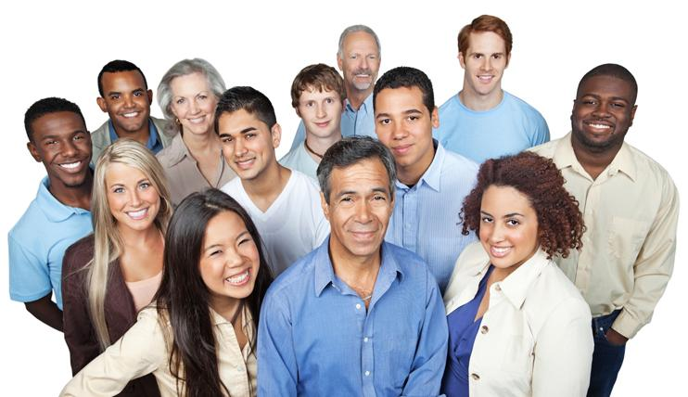
Registering to Vote - WHO
New voter in WI
Changed name
Moved
Notes:
Let’s look at voter registration.
There are 3 basic concepts in voter registration - who needs to register, when to register and how to register. Let’s start with who needs to register to vote. First, new voters in Wisconsin. New voters are people who are not currently registered to vote in Wisconsin, either brand new voters as well as voters who have moved from another state where they were registered. The next group of voters who need to register (or re-register) are voters who have changed their name since the last time they voted. And the last group of voters are those who have moved since the last time they voted.

Slide 10
Registering to Vote - WHEN
Up to 20 days before election
Online, by mail, clerk’s office
Up through Friday before election
Clerk’s office and absentee voting locations
Election Day
Your polling place
Notes:
The next registration concept is when can you register.
1. Up to 20 days before an election, you have several options - online, by mail, or at the clerk’s office.
2. Up through Friday before an election, your choices narrow. You can register at the clerk’s office or at any absentee voting location.
3. And on election day, there is still registration at your polling place.

Slide 11
Registering to Vote - HOW
Online
Form with proof of residence
Notes:
Finally, there is the concept of how voters can register. There are 2 options.
The first option is online registration. For an online registration, the voter completes their registration from start to finish at the MyVote website. At no point in the process does the voter need to fill-in or submit a form and the voter does not need to submit proof of residence.
The second option is registration with a form which the voter can complete in 2 different ways. The voter can use a paper form from the start or the voter can begin the registration process at the MyVote website, fill in their information online but then print out the form to submit to the municipal clerk.
A critical difference between an online registration vs using a form is that when you use a form, the voter must take the additional step to submit proof of residence.

Slide 12
How to Register - Online
Things you can do at MyVote.wi.gov
Online Voter Registration
Polling Place
Voting History
Elected Officials
Request an Absentee Ballot
Sample Ballot
Notes:
Let’s look at the first way that you can register which is online.
You can register online at the MyVote website.
Everyone should become familiar with this very informative website.
It’s not just for registering but provides other valuable information -
your polling place,
voting history,
your elected officials.
you can request an absentee ballot and
view a sample ballot

Slide 13
How to Register - Online
Must have a valid unexpired Wisconsin driver license or Wisconsin DOT-issued ID card
Name, DOB & address used for registration must match the name, DOB and address at DMV
Must be 18 years of age
Available to the voter up to 20 days before an election
Notes:
To complete an online registration, voters must meet certain requirements.
First the voter must have a valid unexpired WI driver license or DOT issued ID card.
Second, the voter’s name, DOB and address used for registration must match the name, DOB and address on record at the DMV.
Finally, the voter must be 18 years of age to complete their registration on MyVote.
Remember, online registration, along with mail-in registration and registering at a registration event, is available to voters only up until 20 days before an election. October 14

Slide 14
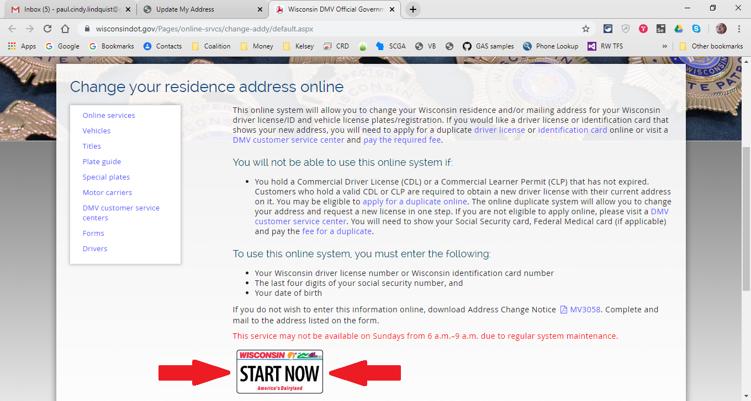
DMV Website
DMV change of address
Notes:
If a voter wants to register online and their address at the DMV is not up to date, they can go to the DMV website and change their address. Once they have changed their address at the DMV website, they can immediately return to the MyVote website to register to vote. Please note that changing the address in the DMV system does not register someone to vote. The voter must go back to the MyVote website to register.

Slide 15
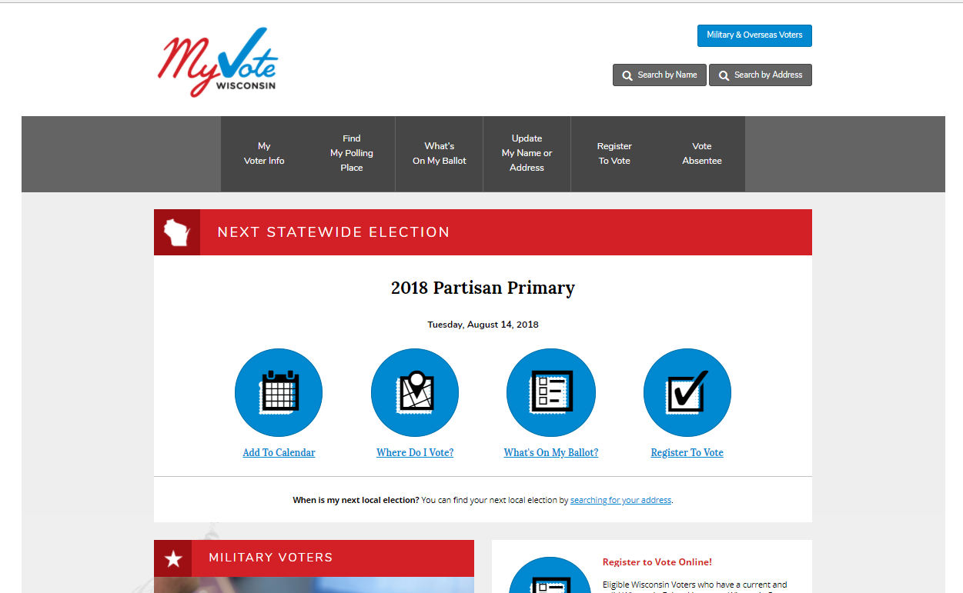
Notes:
Let’s take a look at the MyVote website so you are familiar with the online registration process. The voter starts by clicking on the Register to Vote tab.

Slide 16
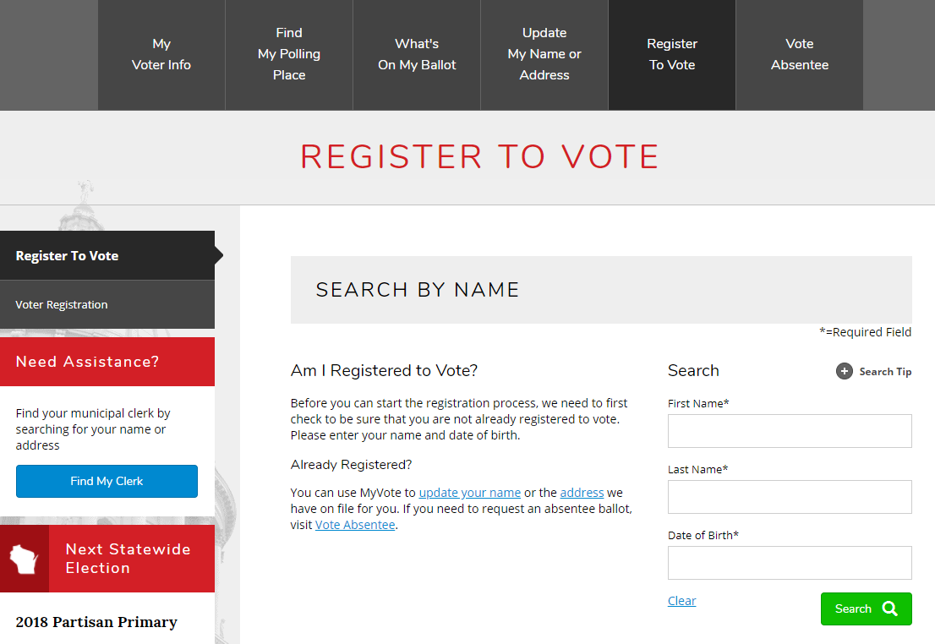
Notes:
On the next screen, the voter types in their name and DOB to access their own record to find out their current registration status.

Slide 17
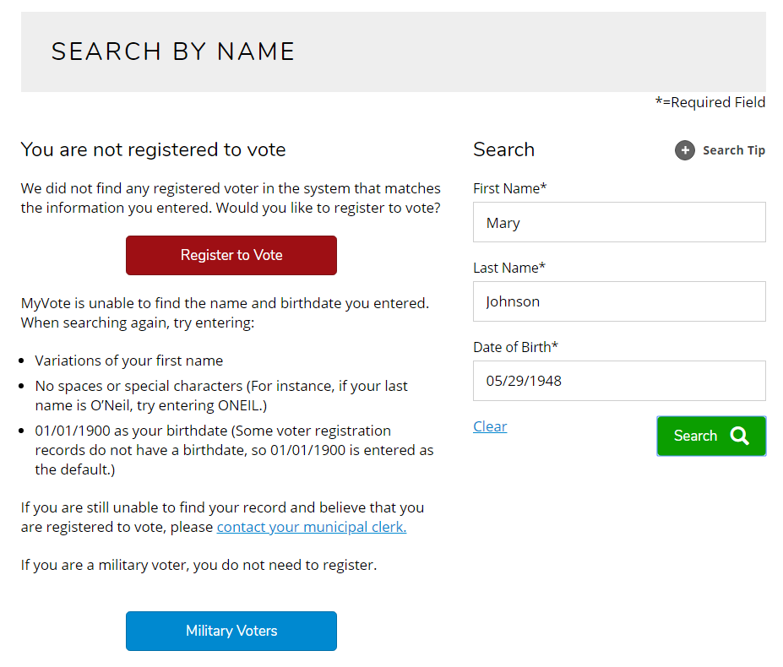
Notes:
One of two pages will open. This page will open if the voter is not registered to vote in Wisconsin. The voter clicks on the Register to Vote button to proceed to register online.

Slide 18
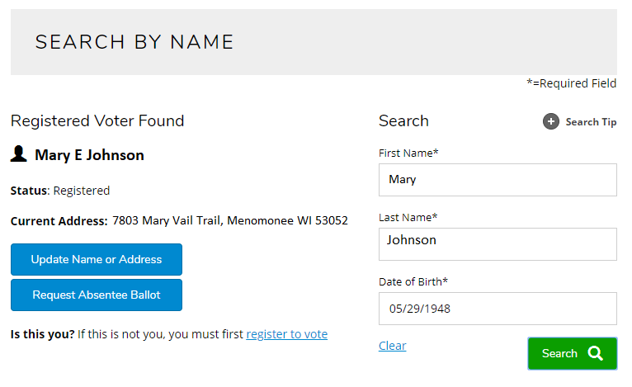
Notes:
This is the alternative page that will open If the voter is currently registered to vote in Wisconsin. It shows the voter’s name and address as they appear in the state registration database. The voter can now choose to update their name and/or address. Please note that updating your name or updating your address is the same as re-registering to vote.

Slide 19
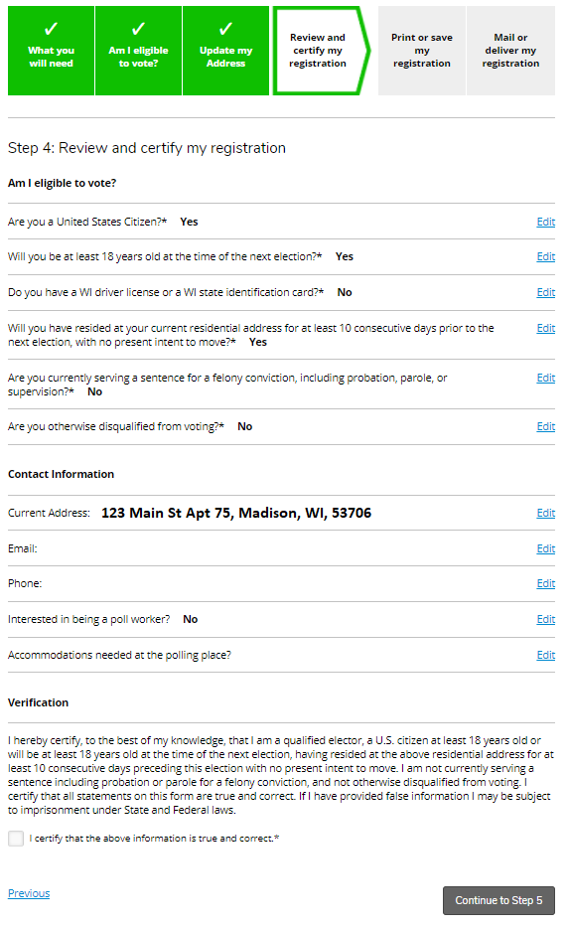
Answers eligibility questions
Verifies information is true and correct
Notes:
The voter then proceeds through a series of questions about their eligibility to vote. And they must certify by checking a box that the information they have provided is correct and true.

Slide 20
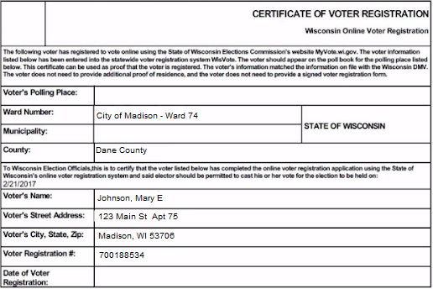
Notes:
The registration certificate, shown here, serves as proof of registration. While the voter may choose to take this certificate to the polls, they are not required to do so.

Slide 21
QUESTIONS?

Slide 22
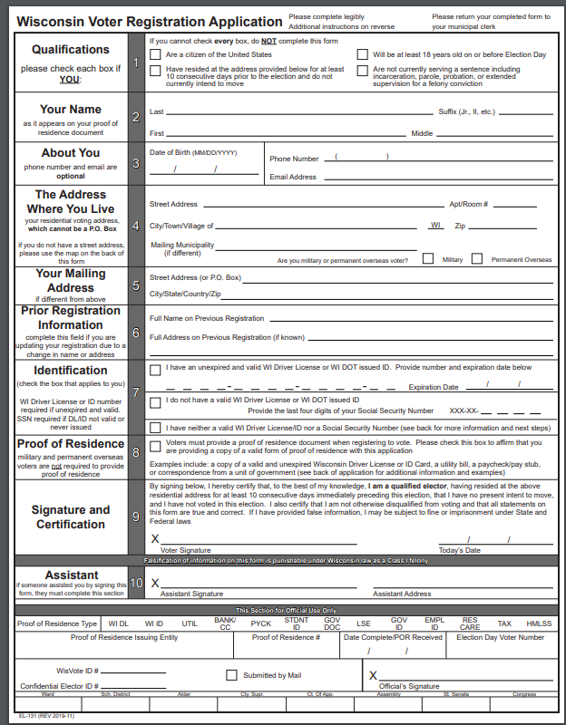
How to Register - Form
Voter’s signature
Proof of Residence
Deliver or mail to the clerk
Voter Registration Form
Notes:
The second way for a voter to register is on a form. When using a form, the voter is required to sign it, submit proof of residence and then deliver or mail the form with proof of residence to their municipal clerk. You can get forms at the clerk’s office or you can download one from the WEC website. The link on this page will take you to the form.

Slide 23
Proof of Residence
Must submit with form registration
Single document that shows
voter’s current name,
voter’s current address, and
document issuer
Can be a paper or electronic document
Notes:
I’ve mentioned that if someone registers with a form, they need to submit proof of residence. Proof of residence is a single document that shows the voter’s name and current address and who issued the document. It can be a paper or electronic document. The proof of residence must be submitted to the voter’s municipal clerk.

Slide 24
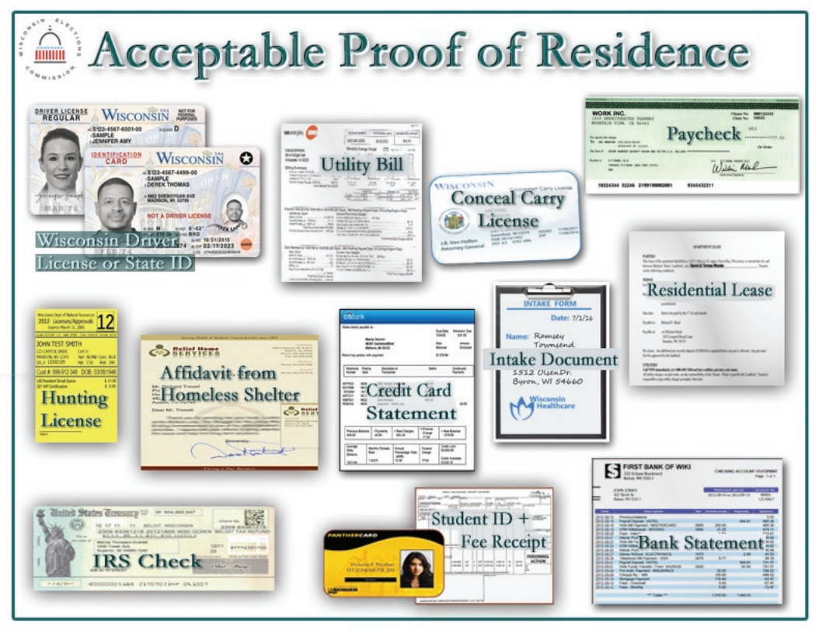
Notes:
Only certain documents are acceptable for proof of residence and they are shown on this screen. For example
WI DL or WI DOT issued ID
utility bill - issued within 90 days
bank statement-
paycheck or pay stub
residential lease
and many many types of government documents
from city, county, state or federal level and from a federally recognized native American tribe Any government document with the voter’s name and address can be used for proof of residence.

Slide 25
QUESTIONS?

Slide 26
How can you help?
Voter Registration
Voter ID
Absentee Voting
Be a poll worker
Notes:
We’ve talked about voter registration as one way you can help other people get ready to vote. The second way you can help people get ready to vote is to make sure they have a photo ID.

Slide 27
Acceptable Voter Photo ID
Voter must show acceptable ID to receive a ballot
Address on ID does not matter for purposes of proving identity
Notes:
Voters must show one of the acceptable photo IDs in order to receive a ballot, either on Election Day at the polls or when voting absentee. The ID does not have to have an address. If it does have an address, the address does not need to be the voter’s current address.

Slide 28
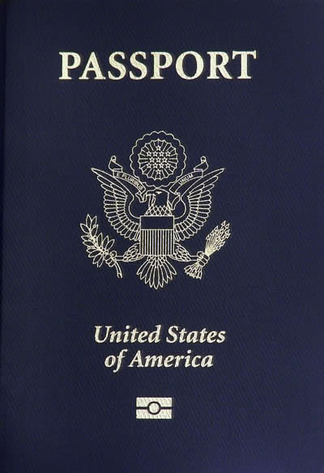
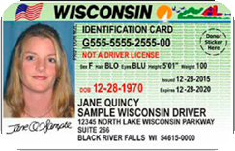
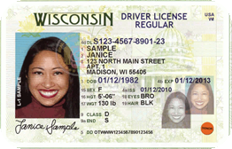
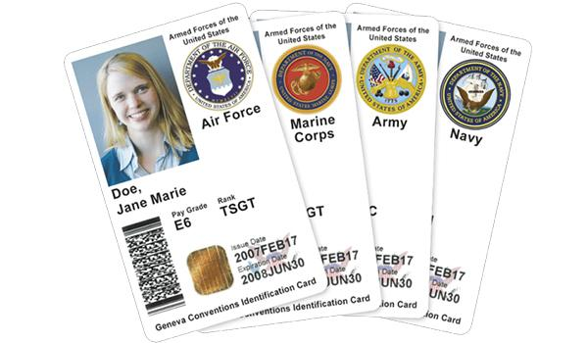
Acceptable Voter Photo ID
unexpired or expired after 11/6/2018
Wisconsin driver license
Wisconsin DOT-issued ID
U.S. passport
Military ID card

Slide 29
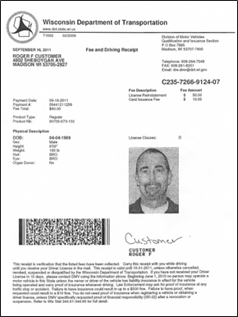
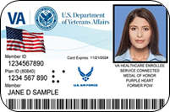
Acceptable Voter Photo ID
Certificate of Naturalization issued within last 2 years
Unexpired Wisconsin driver license/state ID receipt
ID card issued by a federally recognized Native American tribe in Wisconsin - unexpired or expired
Unexpired or non-expiring Veterans Affairs ID

Slide 30
Acceptable Voter Photo ID
ID issued by a Wisconsin accredited university or college
Issuance date
Expiration within 2 years of issuance (can be expired)
Student signature & picture
Accompanied by proof of current enrollment ( if expired)
Notes:
An ID issued by a Wisconsin accredited university or college with certain features. Not all standard college the necessary features and so schools like UW Madison have had to issue separate special voting IDs that meet the requirements for voting.

Slide 31
Voter Photo ID
REAL ID-Compliant DL/ID not required for voting
Free ID for voting available at the DMV
Notes:
Some interesting facts about a voter ID in Wisconsin:
A real ID compliant DL/ID is not needed for voting
Voters can get an ID for free at the DMV to use for voting. If the voter does not have all of the required documents, they can use the ID Petition Process in which the DMV researches personal information for the voter so they can get an ID.

Slide 32
QUESTIONS?

Slide 33
How can you help?
Voter Registration
Voter ID
Absentee Voting
Be a poll worker
Notes:
We’ve talked about helping people register to vote and helping them get a voter ID as ways you can ensure that other people get ready to vote. The third way you can help people get ready to vote is to inform them about absentee voting and if they decide to vote absentee, encourage them to vote early.

Slide 34
Absentee Voting
In-Person
By Mail
Notes:
There are 2 types of absentee voting
in-person which often referred to as early voting.
and voting by mail where the ballot is mailed to the voter and the voter returns it by mail, or with the current election, return it in a drop box

Slide 35
Absentee Voting
Encourage people to request and return absentee ballot early
MyVote
Request using a form
Help someone upload or copy their ID
Find a witness for the ballot
Indefinitely confined
Notes:
Encourage people to request an absentee ballot now. They can request a ballot in 2 ways
MyVote website
submit a request on paper form
WEC mailing requests to all registered voters in September
However they submit their request they must provide a copy of their photo ID
When you request your absentee ballot at MyVote, you need to upload a picture of the ID
if you send in a request by paper application, you need to include a paper copy of you photo ID
You can help by helping someone upload a photo on their phone or making a copy of their ID for them if they don’t have a copier
Another way you can help with absentee voting is to serve as a witness. When you vote absentee, a witness must sign and write their address on the outside of the mailing envelope. You can help by signing the envelope as the witness or finding a witness for the voter. Husband and wife or roommates can sign as witnesses for each other.
Finally, if you know a senior or person with a disability who has difficulty getting to the polls, they can ask to be on a list for indefinitely confined - they write a letter or complete a form saying they are indefinitely confined and they will automatically receive a ballot in the mail for every election as long as they return the ballot for each election. And when you are on the permanent absentee list, you do not need to submit an ID.

Slide 36
QUESTIONS?

Slide 37
How can you help?
Voter Registration
Voter ID
Absentee Voting
Be a poll worker
Notes:
We’ve talked about helping people register to vote, helping them get a voter ID and helping them vote absentee. The fourth way you can help is to become a poll worker and encourage others to do the same.

Slide 38
Why be a poll worker?
More people are likely to vote:
shorter lines
smoother operation
Notes:
Why should you be a poll worker? Elections are better run and more fair. When there are enough poll workers, more people are likely to vote:
the shorter the lines
smoother operation at polling places

Slide 39
Qualifications
Qualified elector of the county
an adult US citizen
reside in the county for 28 consecutive days
not otherwise disqualified to vote
Read and write fluently in the English language
NOT be a candidate for any office to be voted on at the polling place at that election

Slide 40
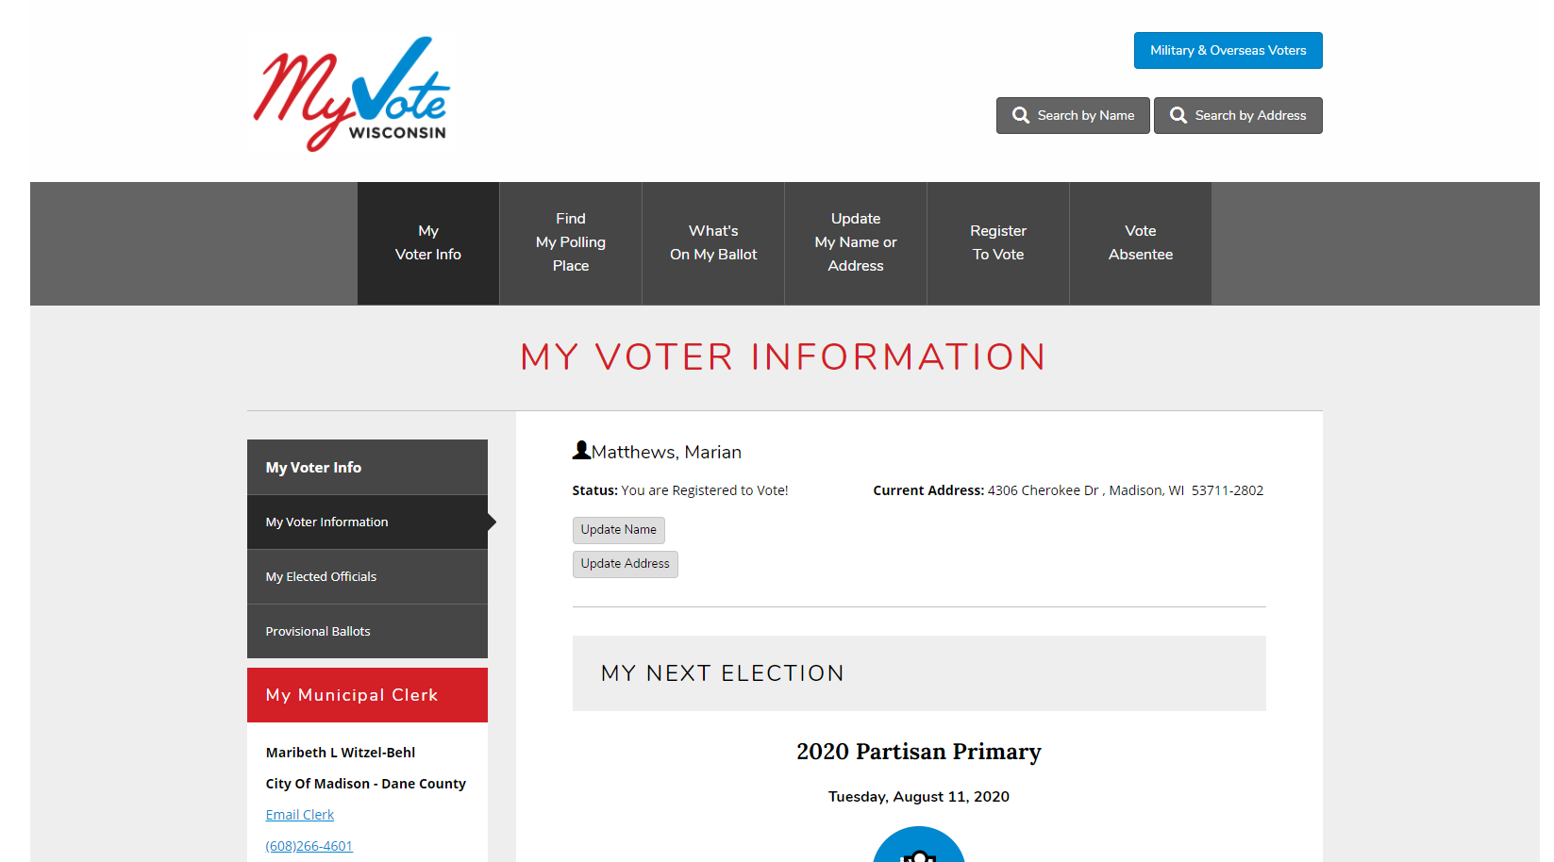
Be a Poll Worker
Notes:
How do you become a poll worker? Contact your municipal clerk. If you need to find our how to contact your clerk, go to myvote.wi.gov, click on My Voter Info, enter your name and DOB and this screen will come up and you can click on the links to contact your clerk.

Slide 41
QUESTIONS?
Voter Helpline 608-285-2141
lwvdanecounty.org
matthm2@charter.net
Notes:
The Voter ID Coalition runs a statewide voter helpline - 608-285-2141 - for any voter questions. The voter can call with their question or if you are helping someone and are unsure of a procedure, call the helpline for more information.
I also encourage you check our LWVDC website for lots more voting information. And I’ve also included my email address if I can be of assistance.

